Slide 1
Chapter 10: File-System Interface

Slide 2
Chapter 10: File-System Interface
10.1 File Concept
10.2 Access Methods
10.3 Directory Structure
10.4 File-System Mounting
10.5 File Sharing
10.6 Protection

Slide 3
Objectives
To explain the function of file systems
To describe the interfaces to file systems
To discuss file-system design tradeoffs, including access methods, file sharing, file locking, and directory structures
To explore file-system protection

Slide 4
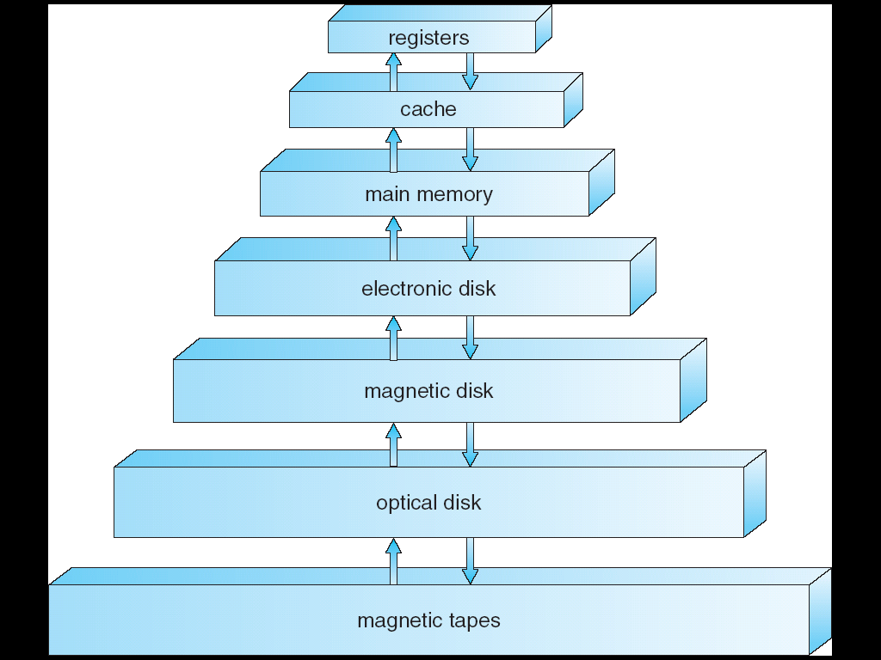
Hierarchical Storage Architecture
very fast
very small
volatile
non-volatile
filesystem manages non-volatile storage
very slow
very large

Slide 5
10.1 File Concept

Slide 6

File Concept
文件是存储某种介质上的（如磁盘、光盘、SSD等）并具有文件名的一组相关信息的集合
A file is a sequence of bytes stored on some device
Types:
Data
numeric
character
binary
Program

Slide 7
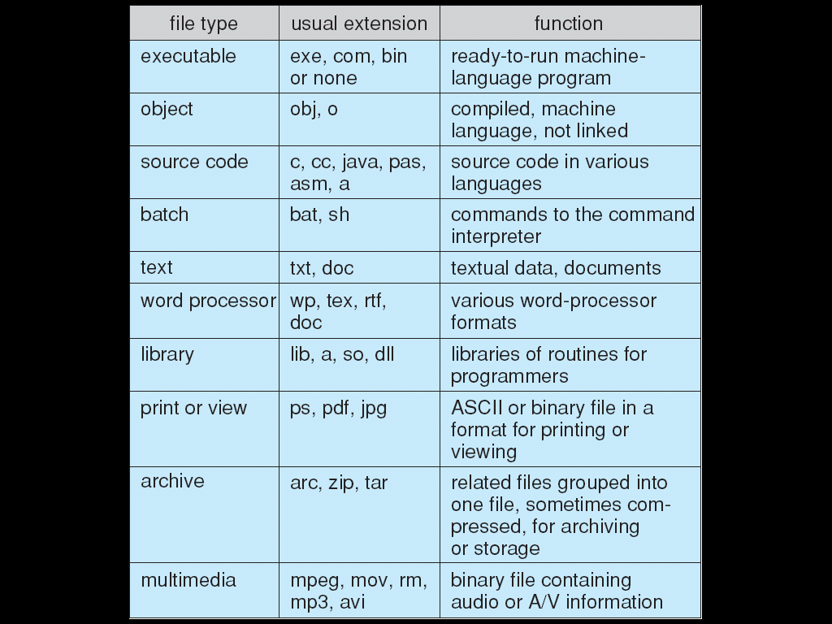
File Types – Name, Extension

Slide 8

File Attributes
Name – only information kept in human-readable form
Identifier – unique tag (number) identifies file within file system
Type – needed for systems that support different types
Location – pointer to file location on device
Size – current file size
Protection – controls who can do reading, writing, executing
Time, date, and user identification – data for protection, security, and usage monitoring
Information about files are kept in the directory structure, which is maintained on the disk

Slide 9
File Operations
File is an abstract data type（抽象数据类型）
Create
Write
Read
Reposition within file
Delete
Truncate
Open(F_{i}) – search the directory structure on disk for entry F_{i}, and move the content of entry to memory
Close (F_{i}) – move the content of entry F_{i} in memory to directory structure on disk

Slide 10
Open Files
Several pieces of data are needed to manage open files:
File pointer: pointer to last read/write location, per process that has the file open
File-open count: counter of number of times a file is open – to allow removal of data from open-file table when last processes closes it
Disk location of the file: cache of data access information
Access rights: per-process access mode information

Slide 11
File Structure（文件内部结构）
None - sequence of words, bytes （流文件结构）
Simple record structure （记录文件结构）
Lines
Fixed length
Variable length
Complex Structures
Formatted document
Relocatable load file
Can simulate last two with first method by inserting appropriate control characters
Who decides:
Operating system
Program

Slide 12
10.2 Access Methods

Slide 13
Access Methods
Sequential Access （顺序存取） Fig 10.2
read next
write next
reset
no read after last write
rewrite
Direct Access （直接存取） Fig 10.3
read n
write n
position to n
read next
write next
rewrite n
n = relative block number
Indexed sequential-acess（索引顺序） Fig 10.4

Slide 14
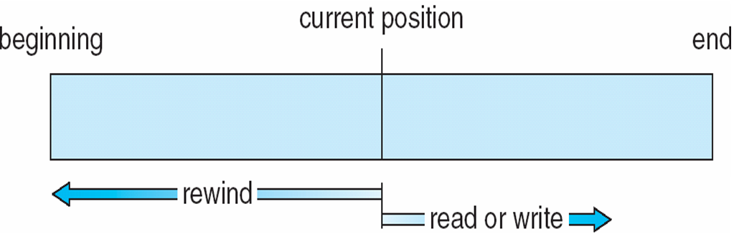
Fig 10.2 Sequential-access File

Slide 15
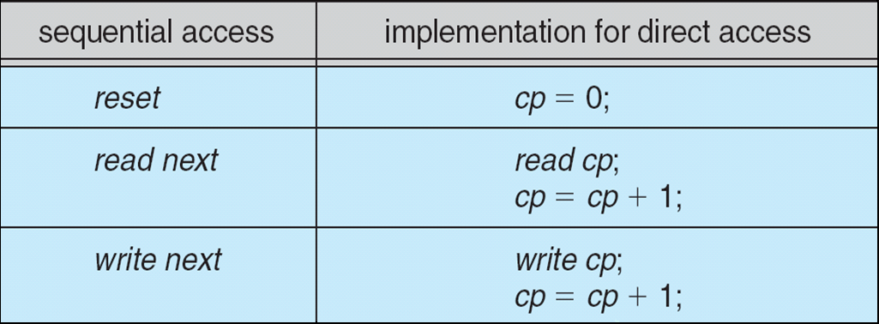
Fig 10.3 Simulation of Sequential Access on Direct-access File

Slide 16
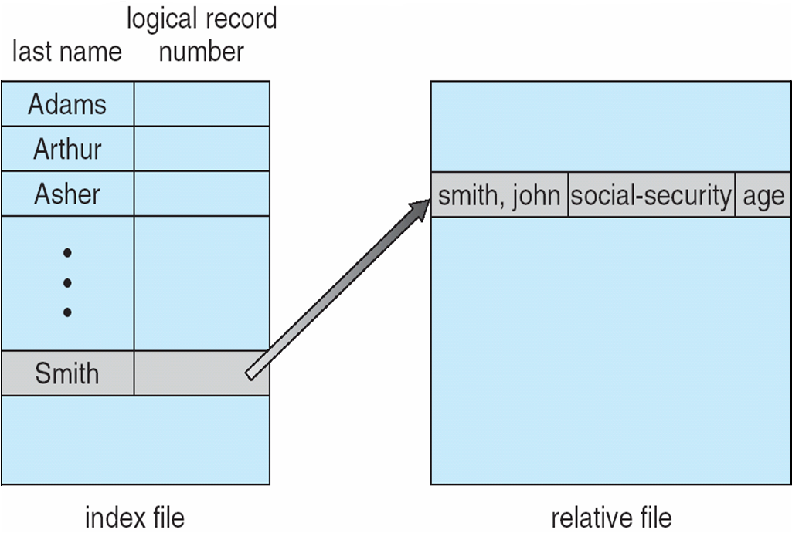
Fig 10.4 Example of Index and Relative Files

Slide 17
10.3 Directory Structure（目录结构）

Slide 18
Directory Structure
A collection of nodes containing information about all files
Directory
Files
F 1
F 2
F 3
F 4
F n
Both the directory structure and the files reside on disk
Backups of these two structures are kept on tapes

Slide 19
Disk Structure
Disk can be subdivided into partitions（分区）
Disks or partitions can be RAID protected against failure
Disk or partition can be used raw – without a file system, or formatted with a file system
Partitions also known as minidisks, slices
Entity containing file system known as a volume
Each volume containing file system also tracks that file system’s info in device directory or volume table of contents
As well as general-purpose files there are many special-purpose file systems, frequently all within the same operating system or computer

Slide 20
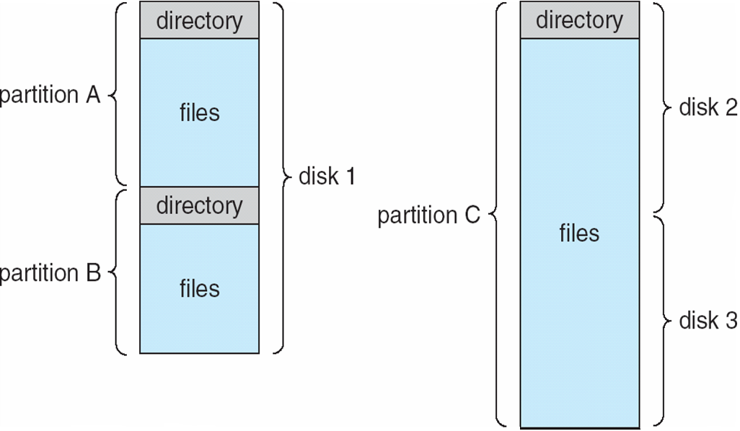
A Typical File-system Organization

Slide 21
Operations Performed on Directory
Search for a file
Create a file
Delete a file
List a directory
Rename a file
Traverse the file system（遍历文件系统）

Slide 22
Organize the Directory (Logically) to Obtain
Efficiency – locating a file quickly
Naming（重名） – convenient to users
Two users can have same name for different files
The same file can have several different names
Grouping（分组） – logical grouping of files by properties, (e.g., all Java programs, all games, …)

Slide 23
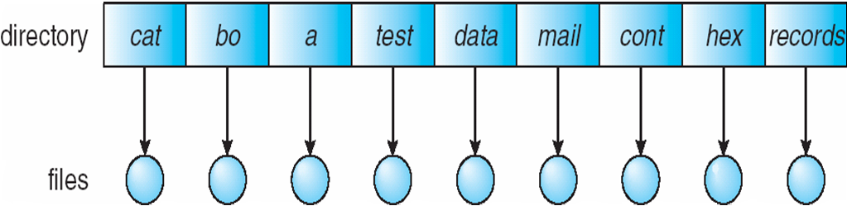
Single-Level Directory（单级目录）
A single directory for all users
Naming problem
Grouping problem

Slide 24
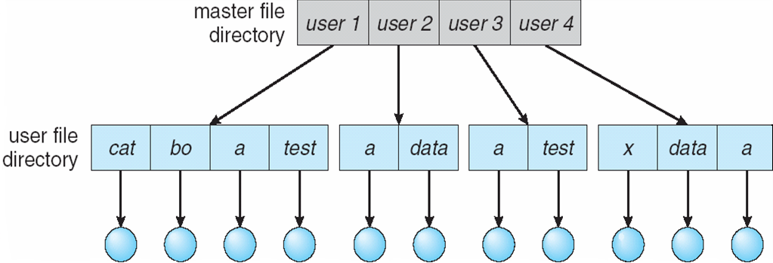
Two-Level Directory（二级目录）
Separate directory for each user
Path name
Can have the same file name for different user
Efficient searching
No grouping capability

Slide 25
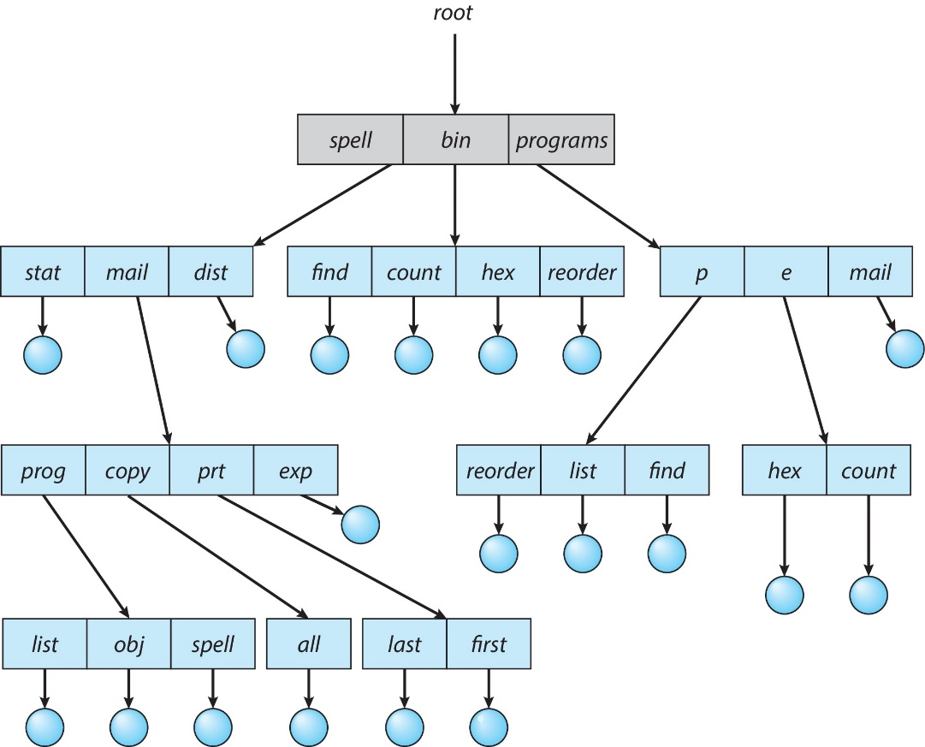
Tree-Structured Directories（树型目录）

Slide 26
Tree-Structured Directories (Cont)
Efficient searching
Grouping Capability
Current directory (working directory)
cd /spell/mail/prog
type list

Slide 27
Tree-Structured Directories (Cont)
Absolute or relative path name 绝对路径、相对路径
Creating a new file is done in current directory
Delete a file
rm <file-name>
Creating a new subdirectory is done in current directory
mkdir <dir-name>
Example: if in current directory /mail
mkdir count
mail
prog
copy
prt
exp
count
Deleting “mail” ⇒ deleting the entire subtree rooted by “mail”

Slide 28
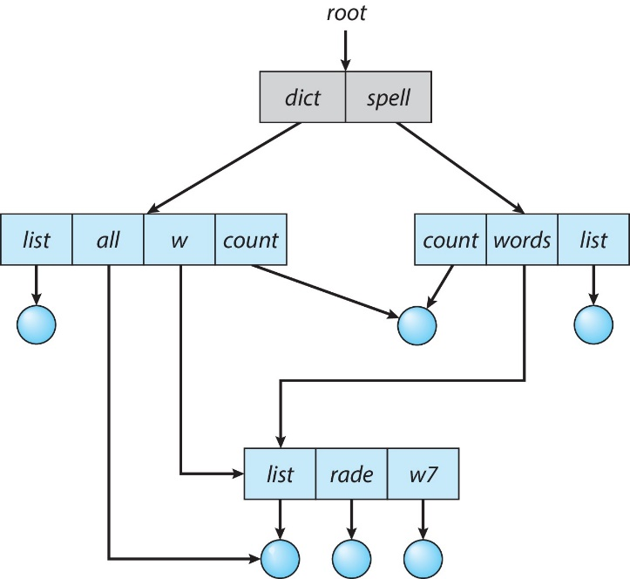
Acyclic-Graph Directories无环图结构目录
Have shared subdirectories and files

Slide 29
Acyclic-Graph Directories (Cont.)
Two different names (aliasing)
If dict deletes all ⇒ dangling pointer
Solutions:
Backpointers（逆向指针）, so we can delete all pointers Variable size records a problem
Backpointers using a daisy chain organization
Entry-hold-count solution （表项保留计数）
unix、linux:hard links
New directory entry type
Link – another name (pointer) to an existing file
Resolve the link – follow pointer to locate the file

Slide 30
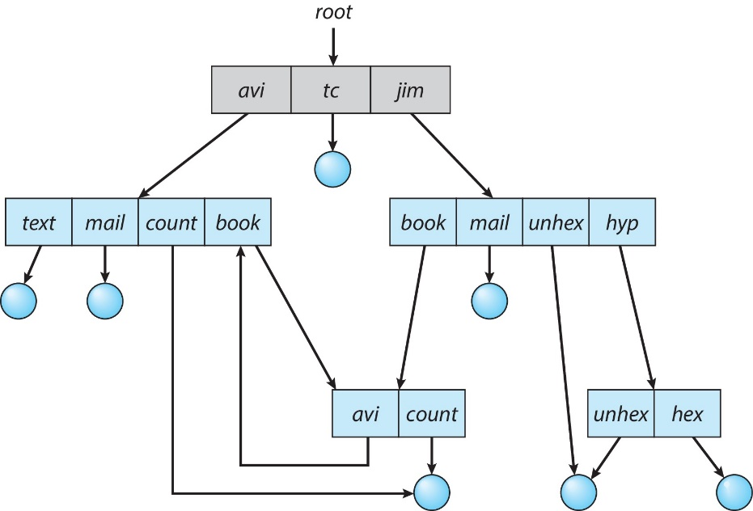
General Graph Directory （普通图结构目录）

Slide 31
General Graph Directory (Cont.)
How do we guarantee no cycles?
Allow only links to file not subdirectories
Garbage collection
检测自我引用的文件，其引用计数不等于0
垃圾收集涉及遍历整个文件系统，并标记所有可访问的空间。然后，第二次将所有没有标记的部分收集到空闲空间链表上。
Every time a new link is added use a cycle detection algorithm（环检测算法） to determine whether it is OK

Slide 32
10.4 File System Mounting

Slide 33
File System Mounting
A file system must be mounted before it can be accessed
A unmounted file system (i.e. Fig. 11-11(b)) is mounted at a mount point

Slide 34
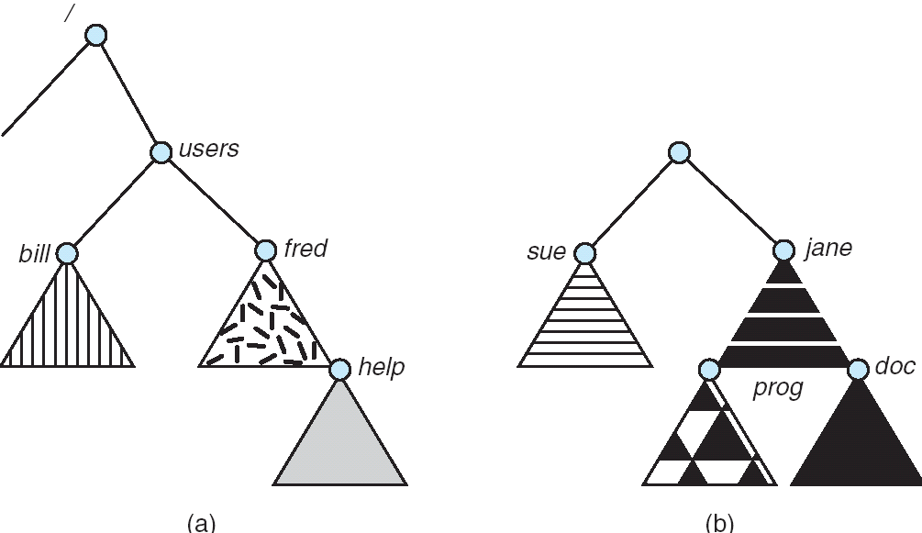
(a) Existing. (b) Unmounted Partition

Slide 35
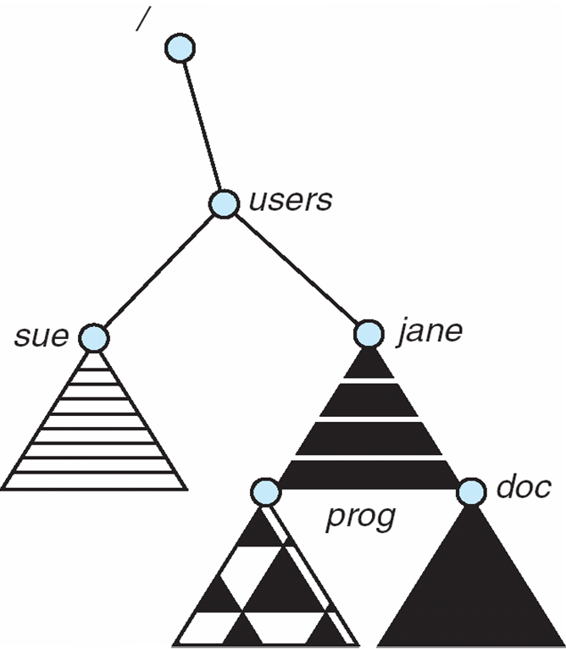
Mount Point

Slide 36
10.5 File Sharing

Slide 37
File Sharing
Sharing of files on multi-user systems is desirable
Sharing may be done through a protection scheme
On distributed systems, files may be shared across a network
Network File System (NFS) is a common distributed file-sharing method

Slide 38
File Sharing – Multiple Users
User IDs identify users, allowing permissions and protections to be per-user
Group IDs allow users to be in groups, permitting group access rights

Slide 39
File Sharing – Remote File Systems
Uses networking to allow file system access between systems
Manually via programs like FTP
Automatically, seamlessly using distributed file systems
Semi automatically via the world wide web
Client-server model allows clients to mount remote file systems from servers
Server can serve multiple clients
Client and user-on-client identification is insecure or complicated
NFS is standard UNIX client-server file sharing protocol
CIFS is standard Windows protocol
Standard operating system file calls are translated into remote calls
Distributed Information Systems (distributed naming services) such as LDAP, DNS, NIS, Active Directory implement unified access to information needed for remote computing

Slide 40
File Sharing – Failure Modes
Remote file systems add new failure modes, due to network failure, server failure
Recovery from failure can involve state information about status of each remote request
Stateless protocols such as NFS include all information in each request, allowing easy recovery but less security

Slide 41
File Sharing – Consistency Semantics
Consistency semantics specify how multiple users are to access a shared file simultaneously
Similar to Ch 7 process synchronization algorithms
Tend to be less complex due to disk I/O and network latency (for remote file systems
Andrew File System (AFS) implemented complex remote file sharing semantics
Unix file system (UFS) implements:
Writes to an open file visible immediately to other users of the same open file
Sharing file pointer to allow multiple users to read and write concurrently
AFS has session semantics
Writes only visible to sessions starting after the file is closed

Slide 42
10.6 Protection

Slide 43
Protection
File owner/creator should be able to control:
what can be done
by whom
Types of access
Read
Write
Execute
Append
Delete
List

Slide 44
Access Lists and Groups
Unix、Linux
Mode of access: read, write, execute
Three classes of users
RWX
a) owner access 7 ⇒ 1 1 1 RWX
b) group access 6 ⇒ 1 1 0
RWX
c) public access 1 ⇒ 0 0 1
Ask manager to create a group (unique name), say G, and add some users to the group.
For a particular file (say game) or subdirectory, define an appropriate access.
owner
group
public
chmod
761
game
Attach a group to a file： chgrp G game

Slide 45
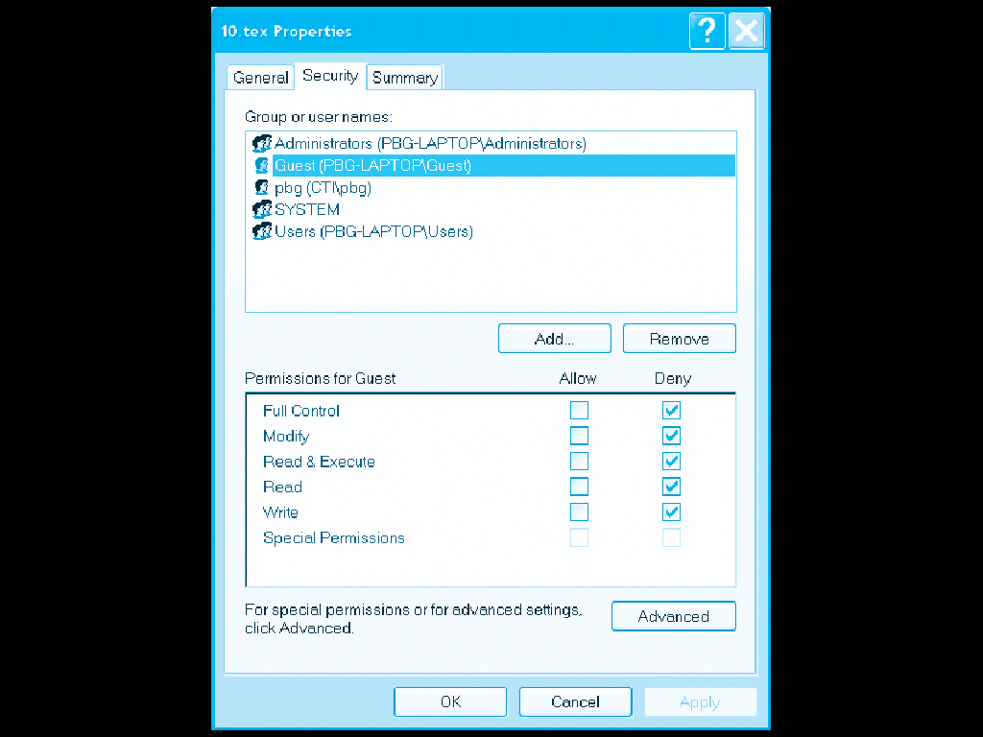
Windows XP Access-control List Management

Slide 46
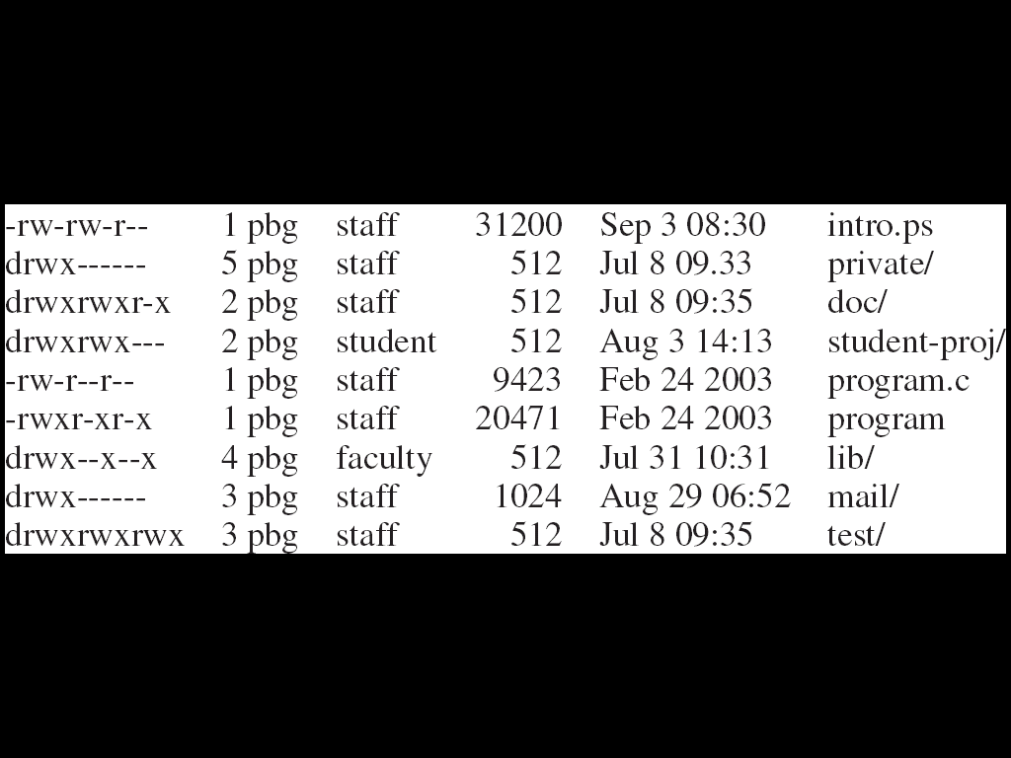
A Sample UNIX Directory Listing

Slide 47
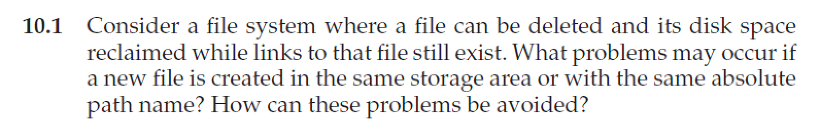
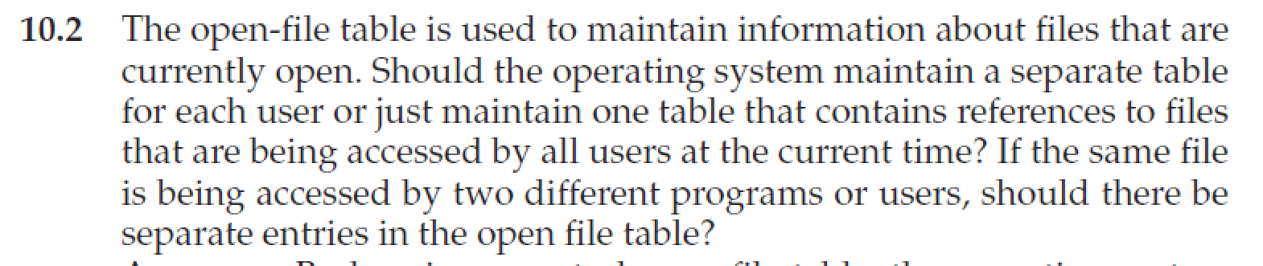
Homework
书后习题10.1、10.2
12月15日晚上12点前提交作业
上传文件时，"名字"填"作业1"、"作业2" 等，"姓氏"请填"个人姓名“
文件名以“学号-姓名-作业x”命名，例如“3170100000-张三-作业1”
有问题可询问TA曾奕久 18888921519 22221190@zju.edu.cn

Slide 48
End of Chapter 10

